Slide 1
(Greedy Methods-2)

Slide 2
Optimization problems
An optimization problem is one in which you want to find, not just a solution, but the best solution
A “greedy algorithm” sometimes works well for optimization problems
But only a few optimization problems can be solved by the greedy method.
Notes:
2

Slide 3
The greedy method
Suppose that a problem can be solved by a sequence of decisions. The greedy method has that each decision is locally optimal. These locally optimal solutions will finally add up to a globally optimal solution.
A greedy algorithm works in phases. At each phase:
You take the best you can get right now, without regard for future consequences
You hope that by choosing a local optimum at each step, you will end up at a global optimum

Slide 4
An simple example
Problem: Pick k numbers out of n numbers such that the sum of these k numbers is the largest.
Algorithm:
FOR i = 1 to k
pick out the largest number and
delete this number from the input.
ENDFOR

Slide 5
Example: Counting money
Suppose you want to count out a certain amount of money, using the fewest possible bills and coins
A greedy algorithm would do this would be: At each step, take the largest possible bill or coin that does not overshoot
Example: To make $6.39, you can choose:
a $5 bill
a $1 bill, to make $6
a 25¢ coin, to make $6.25
A 10¢ coin, to make $6.35
four 1¢ coins, to make $6.39
For US money, the greedy algorithm always gives the optimum solution
Notes:
3

Slide 6
A failure of the greedy algorithm
In some (fictional) monetary system, “krons” come in 1 kron, 7 kron, and 10 kron coins
Using a greedy algorithm to count out 15 krons, you would get
A 10 kron piece
Five 1 kron pieces, for a total of 15 krons
This requires six coins
A better solution would be to use two 7 kron pieces and one 1 kron piece
This only requires three coins
The greedy algorithm results in a solution, but not in an optimal solution
Notes:
4

Slide 7
A scheduling problem
You have to run nine jobs, with running times of 3, 5, 6, 10, 11, 14, 15, 18, and 20 minutes
You have three processors on which you can run these jobs
You decide to do the longest-running jobs first, on whatever processor is available
P1
P2
P3
20
10
3
18
11
6
15
14
5
Time to completion: 18 + 11 + 6 = 35 minutes
This solution isn’t bad, but we might be able to do better
Notes:
5

Slide 8
Another approach
What would be the result if you ran the shortest job first?
Again, the running times are 3, 5, 6, 10, 11, 14, 15, 18, and 20 minutes
P1
P2
P3
3
10
15
5
11
18
6
14
20
That wasn’t such a good idea; time to completion is now 6 + 14 + 20 = 40 minutes
Note, however, that the greedy algorithm itself is fast
All we had to do at each stage was pick the minimum or maximum
Notes:
6

Slide 9
An optimum solution
Better solutions do exist:
P1
P2
P3
20
14
18
11
5
15
10
6
3
This solution is clearly optimal (why?)
Clearly, there are other optimal solutions (why?)
How do we find such a solution?
One way: Try all possible assignments of jobs to processors
Unfortunately, this approach can take exponential time
Notes:
7

Slide 10
Huffman encoding
The Huffman encoding algorithm is a greedy algorithm
You always pick the two smallest numbers to combine
Average bits/char: 0.22*2 + 0.12*3 + 0.24*2 + 0.06*4 + 0.27*2 + 0.09*4 = 2.42
The Huffman algorithm finds an optimal solution
100
54
27
A=00 B=100 C=01 D=1010 E=11 F=1011
46
15
22 12 24 6 27 9 A B C D E F
Notes:
8

Slide 11
Traveling salesman
A salesman must visit every city (starting from city A), and wants to cover the least possible distance
He can revisit a city (and reuse a road) if necessary
He does this by using a greedy algorithm: He goes to the next nearest city from wherever he is
From A he goes to B
From B he goes to D
This is not going to result in a shortest path!
The best result he can get now will be ABDBCE, at a cost of 16
An actual least-cost path from A is ADBCE, at a cost of 14
A
B
C
2
4
3
3
4
4
D
E
Notes:
10

Slide 12
Analysis
A greedy algorithm typically makes (approximately) n choices for a problem of size n
(The first or last choice may be forced)
Hence the expected running time is: O(n * O(choice(n))), where choice(n) is making a choice among n objects
Counting: Must find largest useable coin from among k sizes of coin (k is a constant), an O(k)=O(1) operation;
Therefore, coin counting is (n)
Huffman: Must sort n values before making n choices
Therefore, Huffman is O(n log n) + O(n) = O(n log n)
Minimum spanning tree: At each new node, must include new edges and keep them sorted, which is O(n log n) overall
Therefore, MST is O(n log n) + O(n) = O(n log n)
Notes:
11

Slide 13
Some other greedy algorithms
Dijkstra’s algorithm for finding the shortest path in a graph
Always takes the shortest edge connecting a known node to an unknown node
Kruskal’s algorithm for finding a minimum-cost spanning tree
Always tries the lowest-cost remaining edge
Prim’s algorithm for finding a minimum-cost spanning tree
Always takes the lowest-cost edge between nodes in the spanning tree and nodes not yet in the spanning tree

Slide 14
JOB SEQUENCING WITH DEADLINES
The problem is stated as below.
There are n jobs to be processed on a machine.
Each job i has a deadline d_{i}≥ 1 and profit p_{i}≥0 .
Each job takes 1 unit of time (simplification)
p_{i} is earned iff the job is completed by its deadline.
Only one machine is available for processing jobs.
Only one job is processed at a time on the machine.

Slide 15
JOB SEQUENCING WITH DEADLINES
We want to find the subset of jobs that maximizes our profit
• This is a restricted version of a general job scheduling
problem, which is an integer programming problem
- Example use in telecom engineering and construction scheduling
- Many small jobs, “profit” proportional to customers served
- This is then combined with integer programming solution for big
jobs

Slide 16
JOB SEQUENCING WITH DEADLINES (Contd..)
A feasible solution is a subset of jobs J such that each job is completed by its deadline.
An optimal solution is a feasible solution with maximum profit value.

Slide 17
JOB SEQUENCING WITH DEADLINES (Contd..)
Example : Let n = 4, (p₁,p₂,p₃,p₄) = (100,10,15,27), (d₁,d₂,d₃,d₄) = (2,1,2,1)
Sr.No. Feasible Processing Profit value
Solution Sequence
(i) (1,2) (2,1) 110
(ii) (1,3) (1,3) or (3,1) 115
(iii) (1,4) (4,1) 127 is the optimal one
(iv) (2,3) (2,3) 25
(v) (3,4) (4,3) 42
(vi) (1) (1) 100
(vii) (2) (2) 10
(viii) (3) (3) 15
(ix) (4) (4) 27

Slide 18
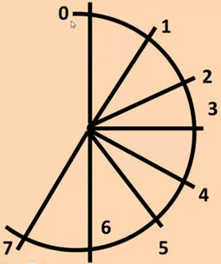
Job Sequencing Problem
Tasks | Deadlines | Profits
T1 | 7 | 15
T2 | 2 | 20
T3 | 5 | 30
T4 | 3 | 18
T5 | 4 | 18
T6 | 5 | 10
T7 | 2 | 23
T8 | 7 | 16
T9 | 3 | 25

Slide 19
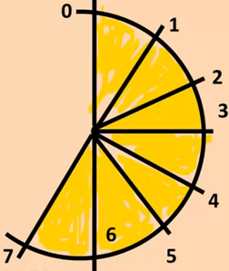
Job Sequencing Problem
Tasks | Deadlines | Profits
T3 | 5 | 30
T9 | 3 | 25
T7 | 2 | 23
T2 | 2 | 20
T4, T5 | 3, 4 | 18
T8 | 7 | 16
T1 | 7 | 15
T6 | 5 | 10
T2
T7
T9
T5
T3
T1
T8
Total Profit 30+25+23+20+18+16+15=147
Solution set (1,1,1,0,1,0,1,1,1)

Slide 20
Job Sequencing Problem
Greedy:
Sort the jobs so that their profit: p1≥ p2 ≥ … ≥ pn
for t : 1… n
S(t) 0 {Initialize array S(1); S(2); … ; S(n)}
end for
for i : 1 … n
Schedule job i in the latest possible free slot meeting its deadline;
if there is no such slot, do not schedule i.
end for

Slide 21
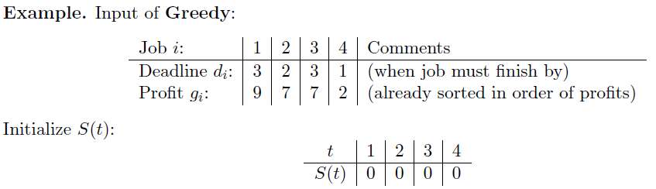
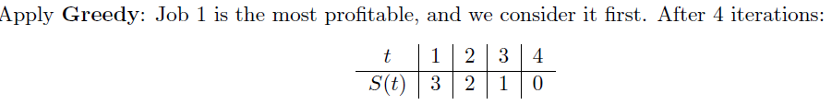
Job 3 is scheduled in slot 1 because its deadline t = 3, as well as slot t = 2, has already been filled.
P(S) = p3 + p2 + p1 = 7 + 7 + 9 = 23

Slide 22
JS(d,j,n,p)
{
// j[1…n] holds n jobs. p[1…n] and d[1…n] are profits and deadlines of jobs. Jobs are ordered such that p[i] > p[i+1]. Slot[1…n] holds flag for each slot indicating whether it is used or not. Jobset[1…n] indicates which jobs are assigned on which slot and X[1…n] is the solution array.
for i=1 to n do
{
Slot[i]=False;
X[i]=0;
}
for i=1 to n do
{
k=d[j[i]];
while (k > 0)
{
if (!slot[k])
{
Slot[k]=True;
Jobset[k] = i;
X[i] = 1;
Break;
}
k--;
}
}
return X;
}
Note: The size of Jobset[ ]and Slot[ ] may change to
max (deadline[i])

Slide 23
Complexity Analysis
Simple greedy job algorithm spends much time looking for latest slot a job can use, especially as algorithm progresses and many slots are filled.
- n jobs would, on average, search n/2 slots
- This would be an O(n²) algorithm
By using our set data structure, it becomes nearly O(n)
- set find and union are O(Ackermann’s function),
which is nearly O(1)
- We invoke n set finds and unions in our greedy algorithm

Slide 24
GREEDY ALGORITHM FOR SEQUENCING UNIT TIME JOBS
Procedure JS(D,J,n,k)
// D(i) ≥ 1, 1≤ i ≤ n are the deadlines //
// the jobs are ordered such that //
// p₁ ≥ p₂ ≥ ……. ≥ p_{n} //
// in the optimal solution ,D(J(i) ≥ D(J(i+1)) //
// 1 ≤ i ≤ k //
integer D(o:n), J(o:n), i, k, n, r
D(0) ←J(0) ← 0
// J(0) is a fictious job with D(0) = 0 //
K←1; J(1) ←1 // job one is inserted into J //
for i ←2 to do // consider jobs in non increasing order of pi //

Slide 25
GREEDY ALGORITHM FOR SEQUENCING UNIT TIME JOBS (Contd..)
// find the position of i and check feasibility of insertion //
r← k // r and k are indices for existing job in J //
// find r such that i can be inserted after r //
while D(J(r)) > D(i) and D(i) ≠ r do
// job r can be processed after i and //
// deadline of job r is not exactly r //
r← r-1 // consider whether job r-1 can be processed after i //
repeat

Slide 26
GREEDY ALGORITHM FOR SEQUENCING UNIT TIME JOBS (Contd..)
if D(J(r)) ≥ d(i) and D(i) > r then
// the new job i can come after existing job r; insert i into J at position r+1 //
for I ← k to r+1 by –1 do
J(I+1)← J(l) // shift jobs( r+1) to k right by//
//one position //
repeat

Slide 27
GREEDY ALGORITHM FOR SEQUENCING UNIT TIME JOBS (Contd..)
J(r+1)←i ; k ←k+1
// i is inserted at position r+1 //
// and total jobs in J are increased by one //
repeat
end JS

Slide 28
COMPLEXITY ANALYSIS OF JS ALGORITHM
Let n be the number of jobs and s be the number of jobs included in the solution.
The loop between lines 4-15 (the for-loop) is iterated (n-1)times.
Each iteration takes O(k) where k is the number of existing jobs.
The time needed by the algorithm is 0(sn) s ≤ n so the worst case time is 0(n²).
If d_{i} = n - i+1 1 ≤ i ≤ n, JS takes θ(n²) time
D and J need θ(s) amount of space.

